Slide 1
Liquid Applied Roof Coatings

Slide 2
In business for 15 years
Largest silicone roof applicator serving the Rocky Mountain Region
Only Uniflex Premier Elite Contractor in Rocky Mountain Region
50% of projects with roofing companies and property managers
Gaco and Uniflex Specialists. Certified with most other top manufacturers
Large crew equipped to handle projects of any scale
Silicone Experts
ABOUT PCS

Slide 3
Free inspections
Will meet your designated contact on site
Turnkey Solutions = Peace of Mind
Conduct pre-inspection
Order and coordinate material
Schedule final inspection
Provide daily progress photos
Strictly a coatings company
WHY PCS?

Slide 4
Globally
2021 4.2 B USD
2022 4.6B USD
2032 8.3B USD
US Market
26% of Global market share
2017-2021 Grew at a CAGR of 7.3% to $1.1B+
2022 $1.4B USD
2032 $2.2B estimated
KeyGrowth Factors
Increase in Corporate Sustainability Initiatives
Upsurge in the adoption of green building codes
Growing concern towards energy consumption & carbon emissions
FLUID APPLIED MARKET

Slide 5
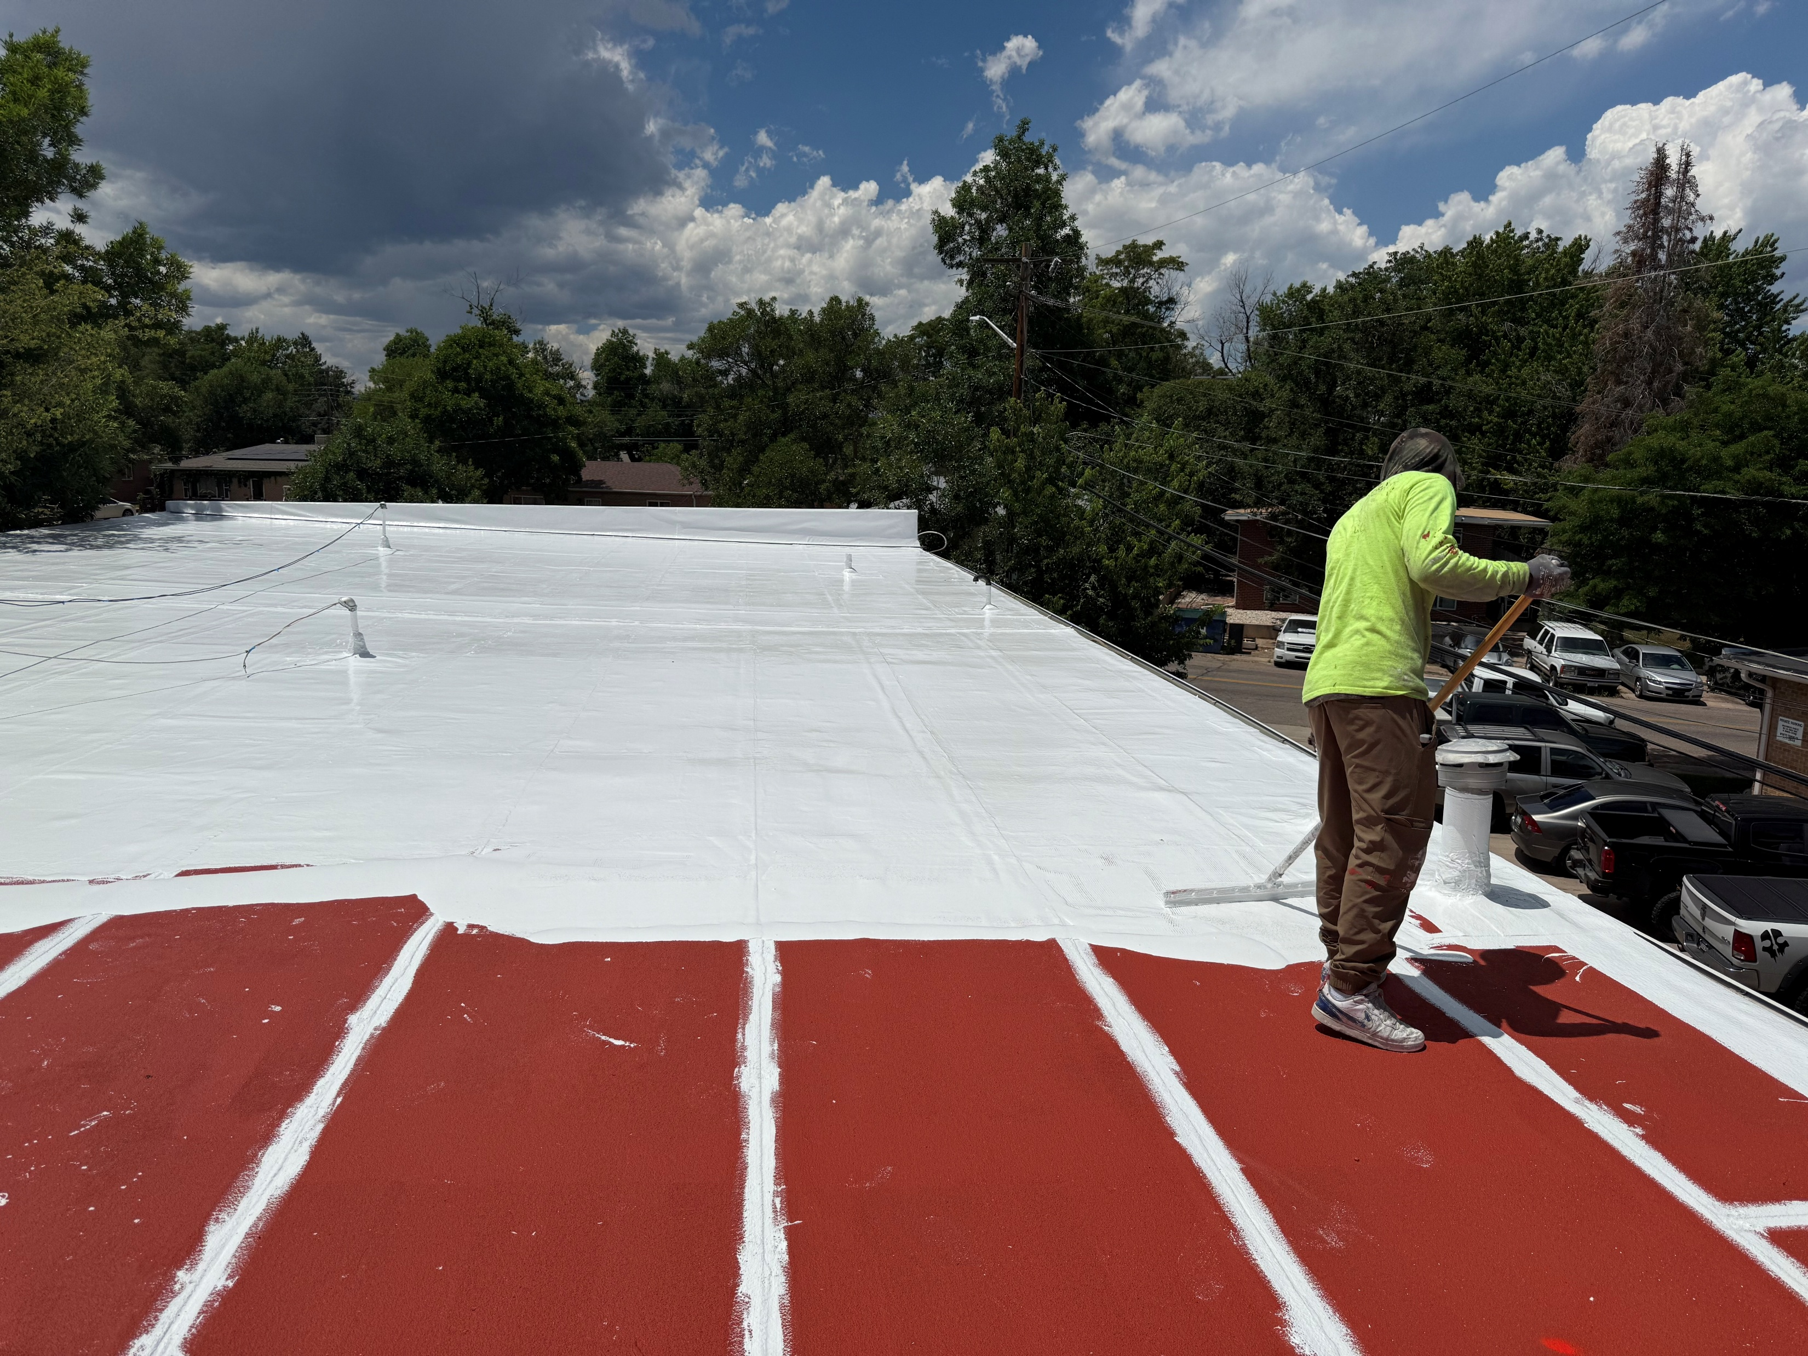
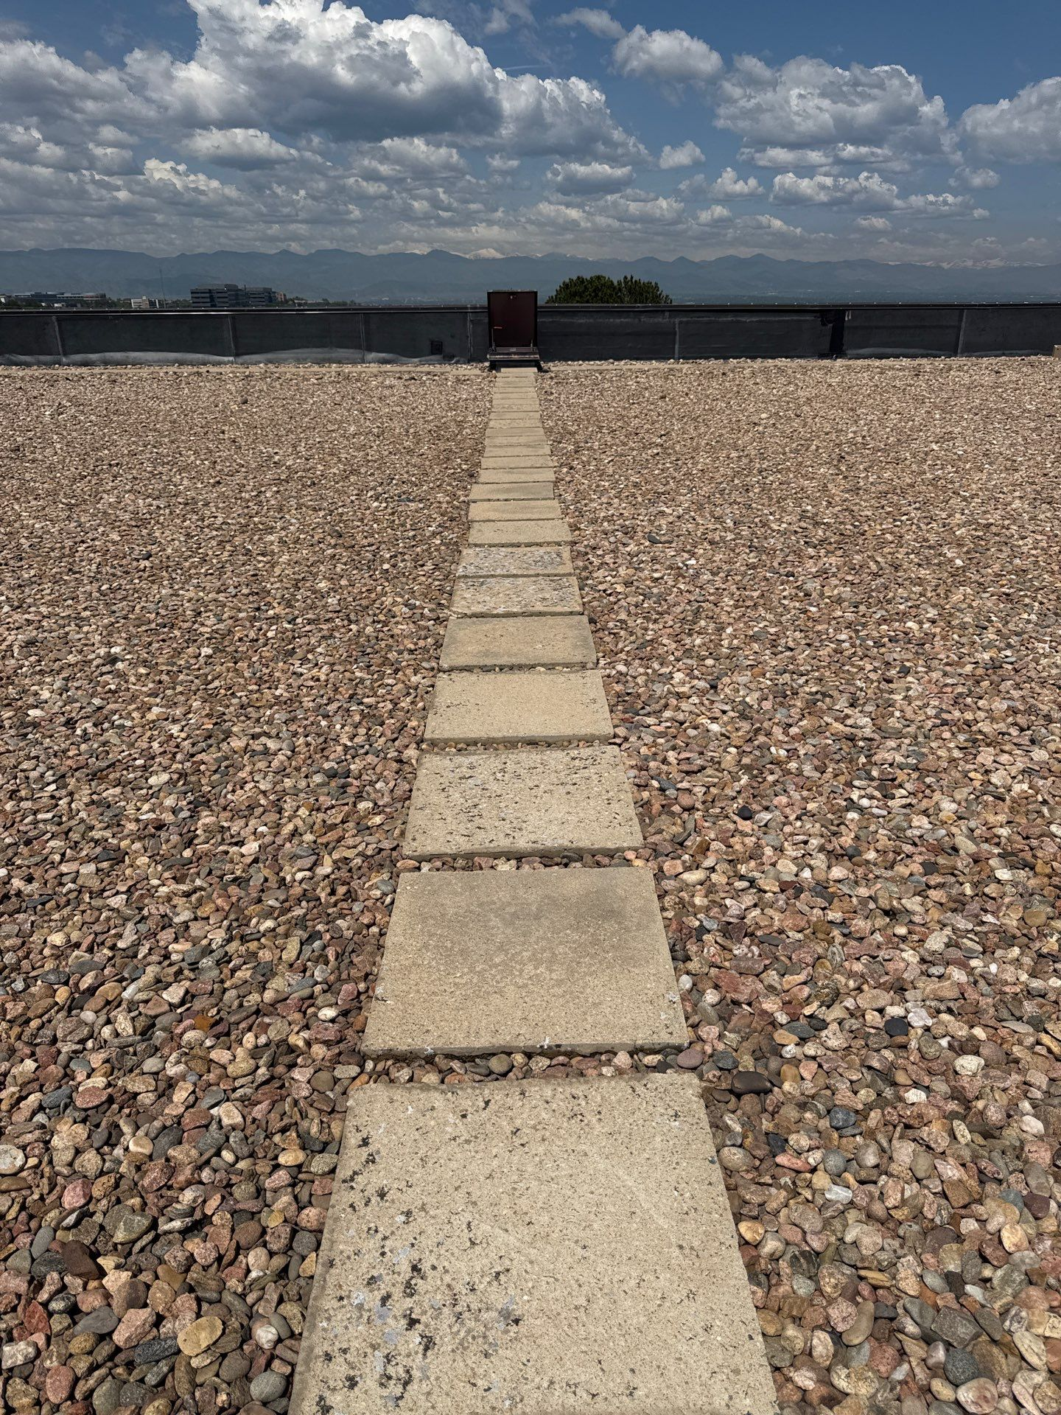
Common Commercial Roofs
Single Ply
EPDM
TPO
PVC
Asphalt
Modified Bitumen
Tar and Gravel
Metal
Standing Seam
Standard Profile
Rock Ballasted
45 mil & 60 mil
FLAT ROOF SYSTEMS

Slide 6
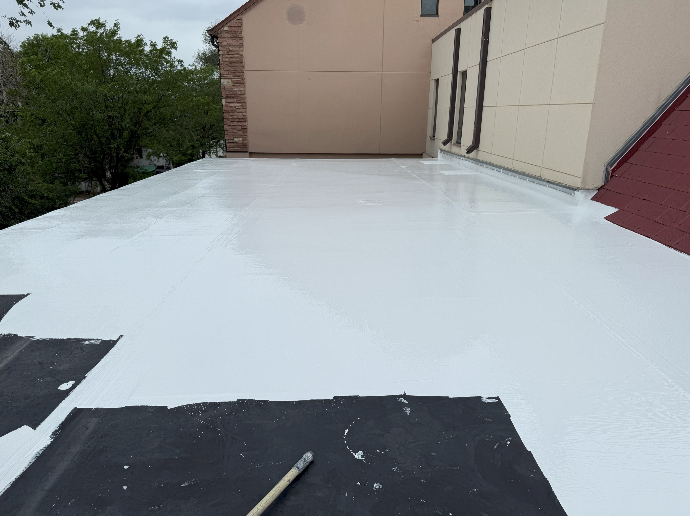
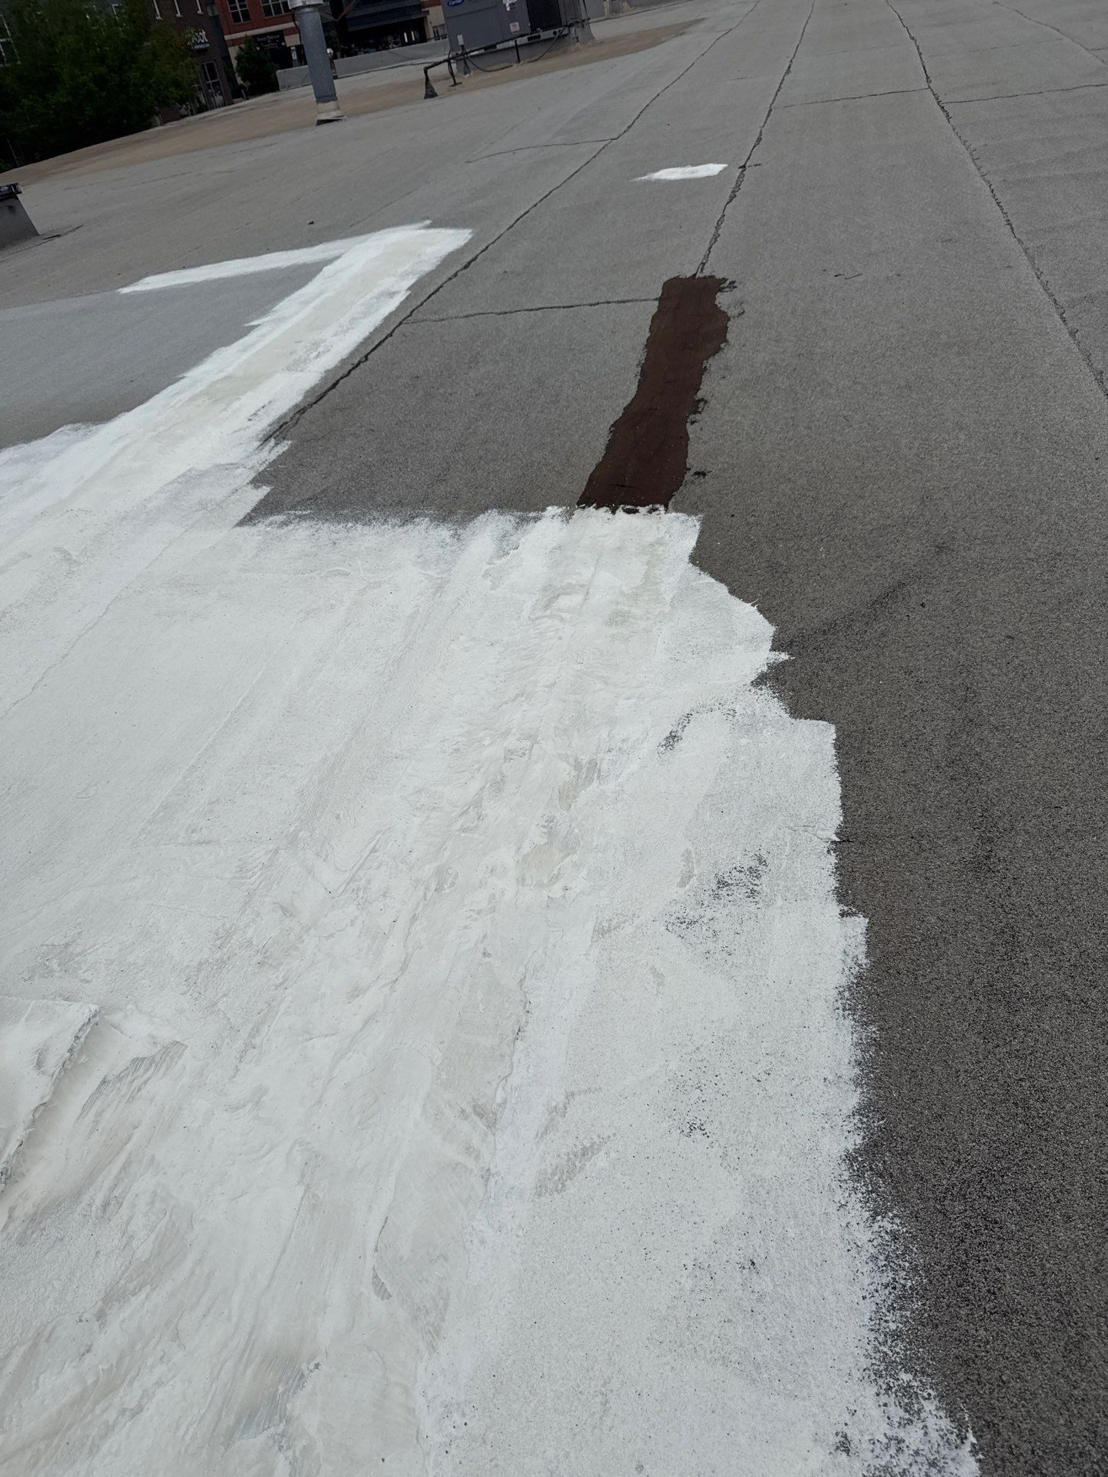
Silicone
One Coat
Non Reinforced
Ponding Water Resistant
Doesn’t lose mil thickness over time
Acrylic
Multi-Coat
Base Coat Required
Used primarily in New Mexico/Nevada
Loses 1-2 mils per year
TECHNOLOGIES

Slide 7
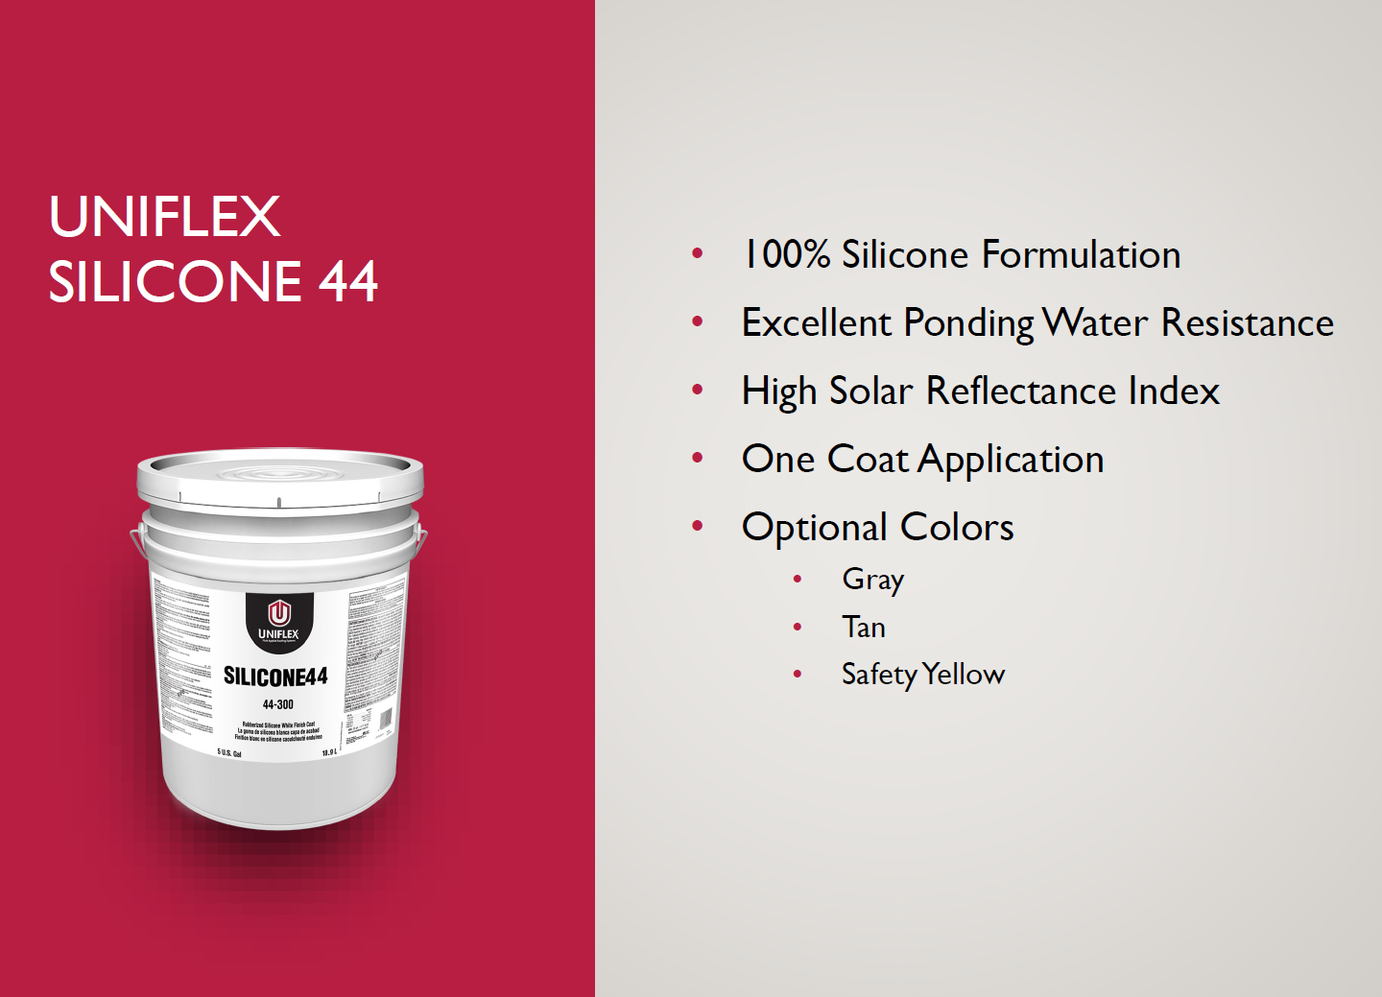
PRODUCT

Slide 8
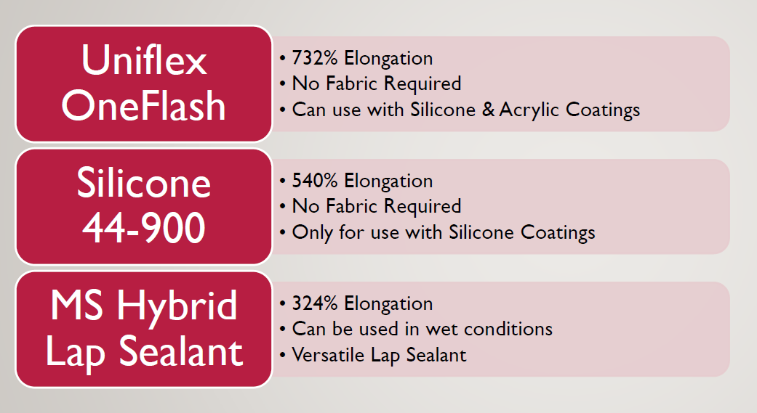
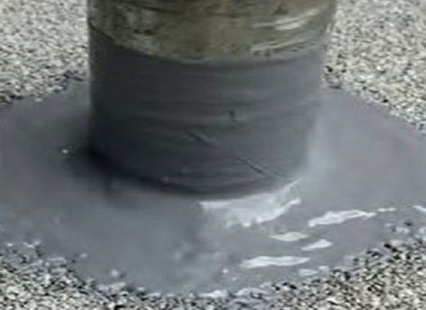
SEALANTS

Slide 9
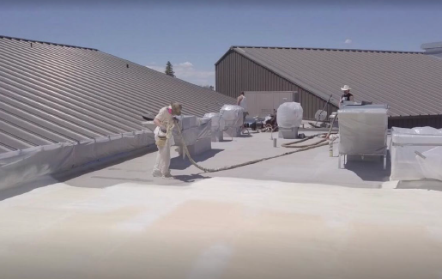
Spray Foam
Application
1 ½ inch of closed cell foam
Silicone top coating
Makes foam UV stable
Withstand permanent ponding water
Ideal for tar and gravel roof systems
Can be applied to all roofing systems
Adds R-value
FOAM + COAT

Slide 10
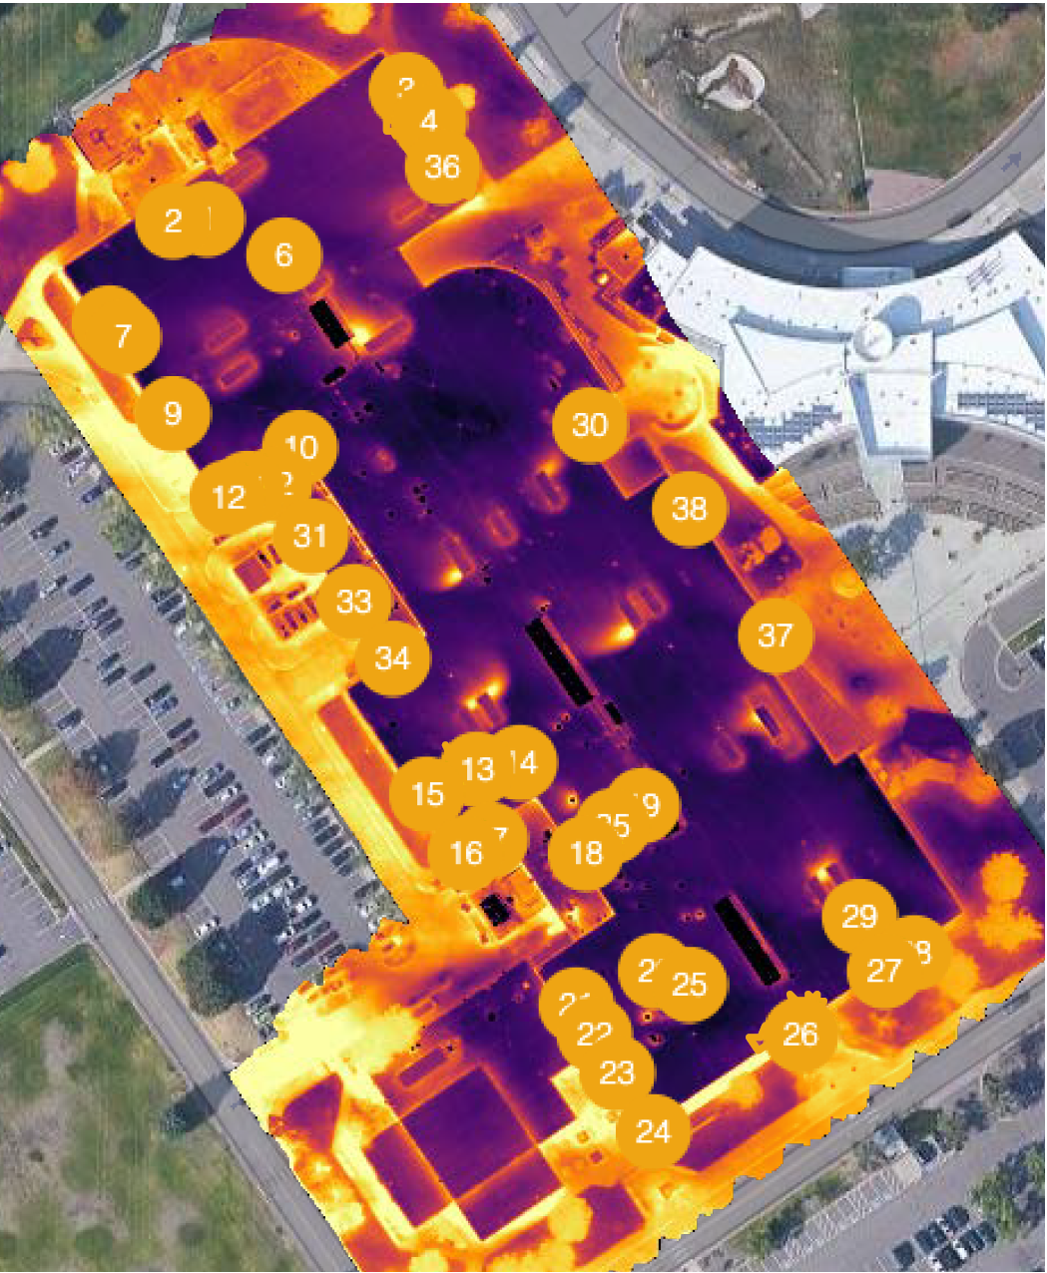
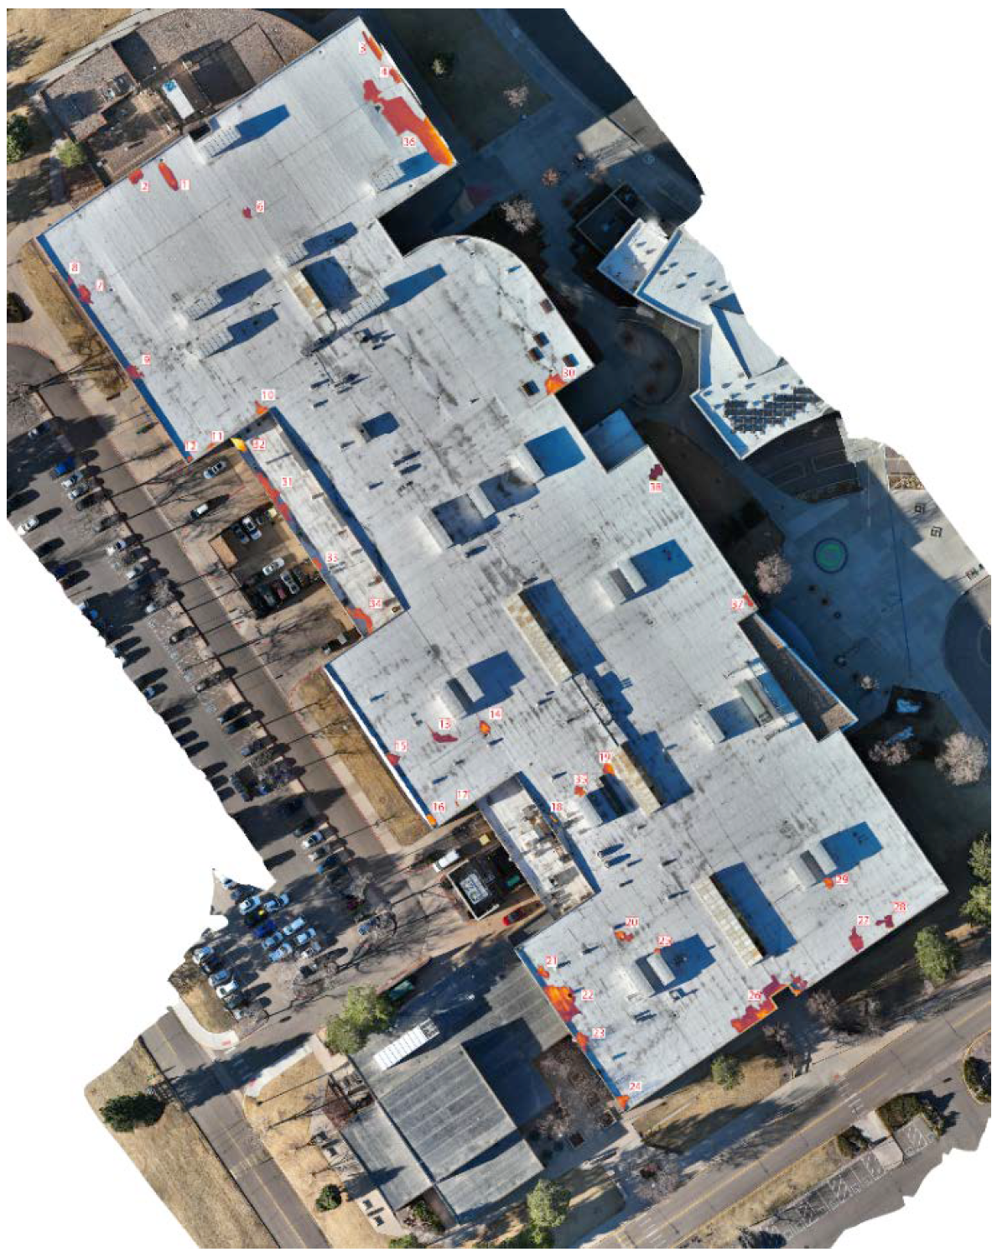
MOISUTRE TESTING

Slide 11
Withstand PERMANENT ponding water
UV Stable
White roof = reflective = energy savings
Creates seamless, monolithic roof system
Excellent hail performance
Retains mil thickness
SILICONE

